Slide 1
Software Documentation Presentation
CODELEARNERSHUB
UNIQUE LEARNING MANAGEMENT SYSTEM (ULMS)
Yunus O. Olalekan
CodeLearnersHub
2022

Slide 2
BACKGROUND
CODELEARNERSHUB
ULMS is a Learning Management System software that allows Instructors to connect with their learners online from anywhere in the world.
It gives Learners access to online training material (courses, guides, quizzes, videos, etc.) any time they want.

Slide 3
What It Does
CODELEARNERSHUB
Create: Build online lessons (or eLearning content, as it’s referred to in the industry). You can take individual lessons and turn them into courses.
Deliver: Assign, offer, or sell those courses to employees, partners, customers, or a wider audience.
Monitor: Enroll and manage your training audiences. You can also track and assess their performance.

Slide 4
Who uses ULMS?
CODELEARNERSHUB
Businesses of all sizes, from large multinational enterprises to small and medium businesses
Government organizations, government agencies, and regional government offices
Non-government organizations and nonprofits
Consulting firms
Traditional educational institutions (schools, universities, colleges)
Online and eLearning-based educational institutions
Independent instructors and coaches

Slide 5
PROBLEM STATEMENT CONT’D
CODELEARNERSHUB
There is an increasing gap between quest for seeking knowledge of teens in last few decades and teens of nowadays
Social media addiction is a growing phenomenon not only in Nigeria but worldwide.
The average person spends nearly 2 hours a day using social media (up to 9 hrs for teens)
Learners of different age groups find it difficult to dedicate time for learning
Instructors struggle to deliver contents in a dynamic form suitable for the need of today’s learners

Slide 6
PROBLEM STATEMENT CONT’D
CODELEARNERSHUB
Existing platforms offers less of individual monitoring of learners and addressing personal challenges.
The Gap is due to the fact that learners are no more where the knowledge is but now on social media.
Hence, ULMS seeks to take the knowledge to them where they are.
With WhatsApp ranked as the most used mobile messenger app in the world (2 billion users) targeted as the starting point.

Slide 7
Features - MultiTenancy And Whatsapp UI
Multitenancy is a form of cloud architecture where multiple clients of a single cloud vendor share the same computing resources.
A single instance of software runs on a server and accommodates numerous tenants.
Types of MultiTenancy : Single and Multiple Database
ULMS adopts hybrid Multitenancy System for accommodating different data usage level and security preferences of tenants.
ULMS provides user interface on Whatsapp messenger to bring learning to users where they are.
CODELEARNERSHUB

Slide 8
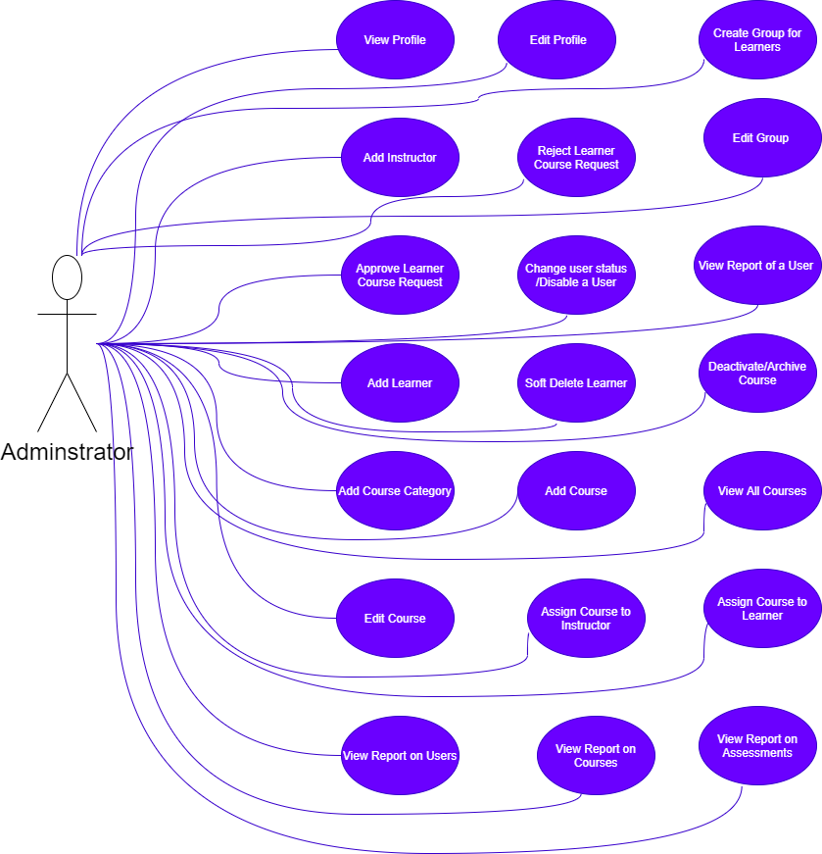
Use-Case Diagram for Administrator
CODELEARNERSHUB

Slide 9
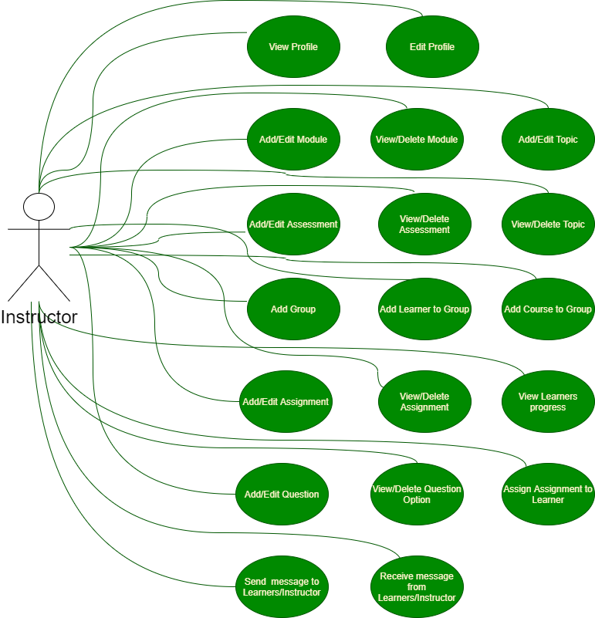
Use-Case Diagram for Instructor
CODELEARNERSHUB

Slide 10
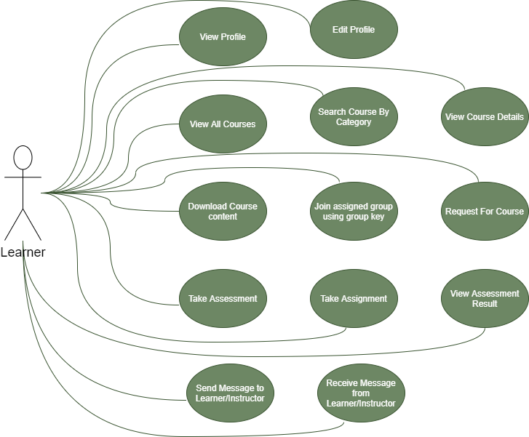
Use-Case Diagram for Learner
CODELEARNERSHUB

Slide 11
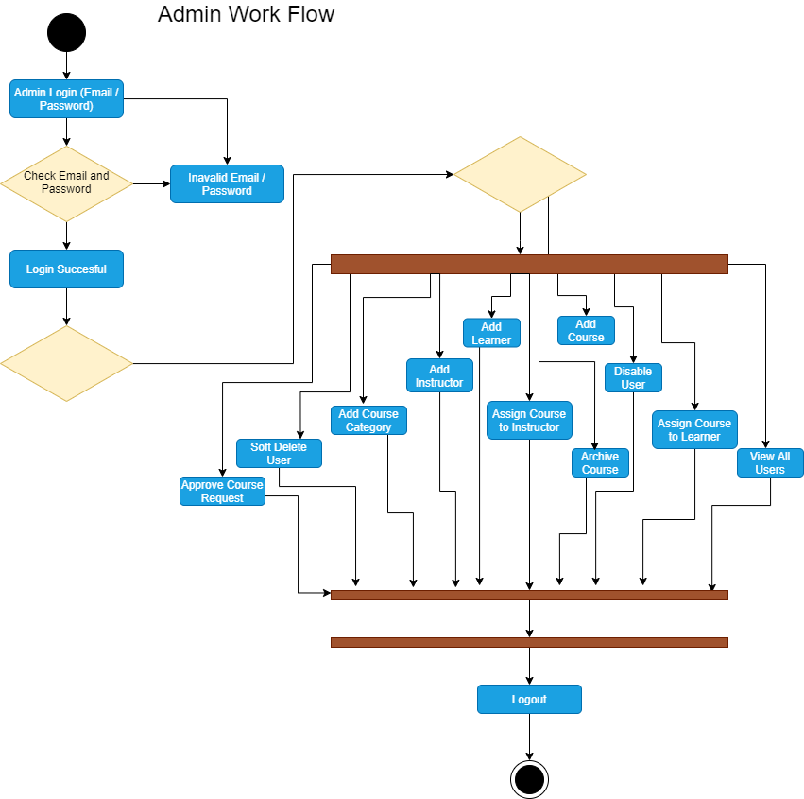
Admin’s Work Flow Diagram
CODELEARNERSHUB

Slide 12
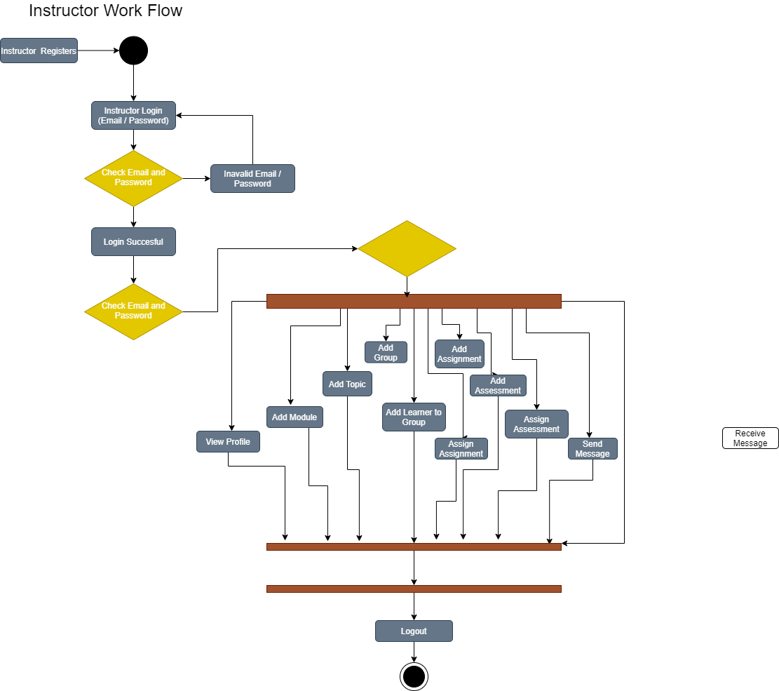
Instructor’s Work Flow Diagram
CODELEARNERSHUB

Slide 13
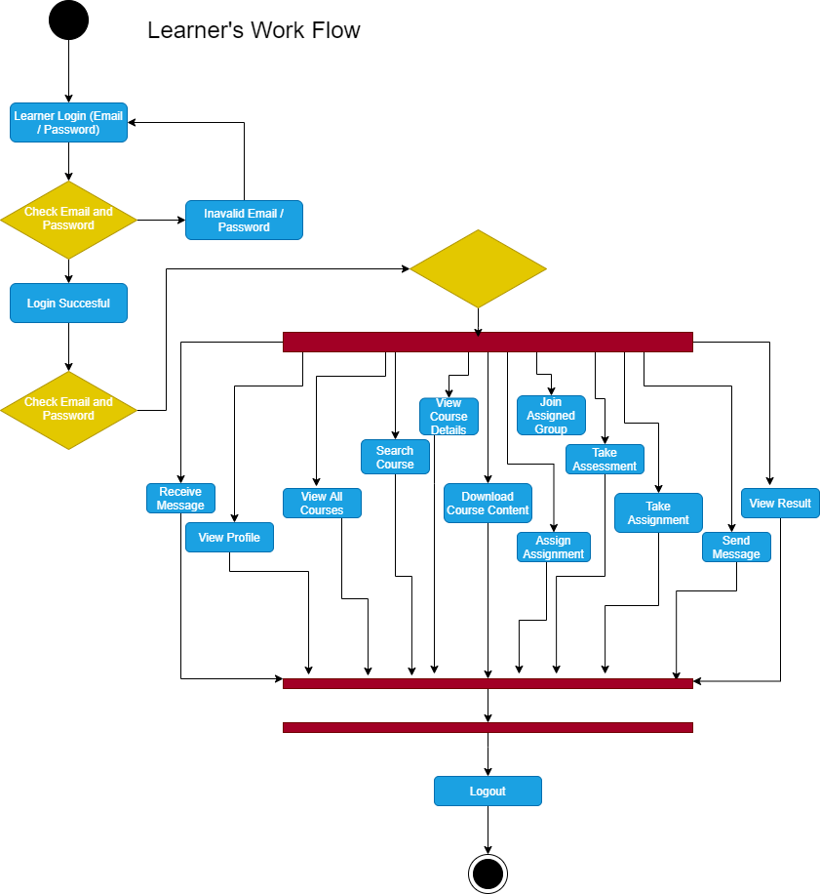
Learner’s Work Flow Diagram
CODELEARNERSHUB

Slide 14
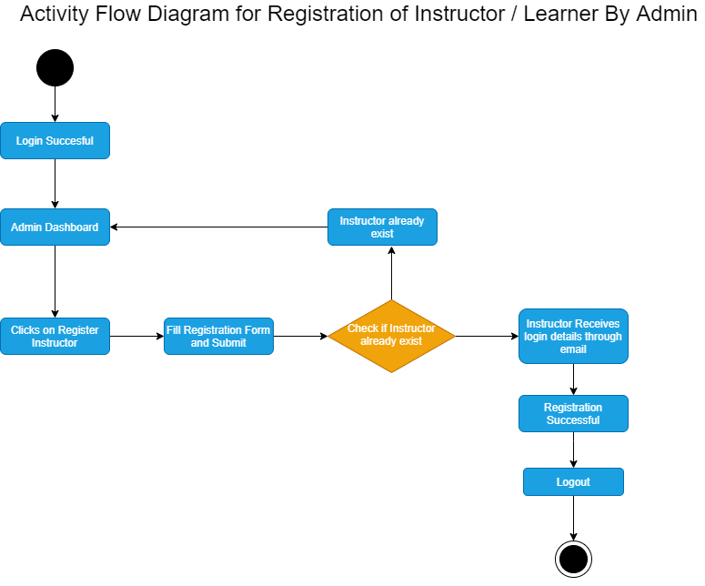
Activity Diagram for Registration
CODELEARNERSHUB

Slide 15
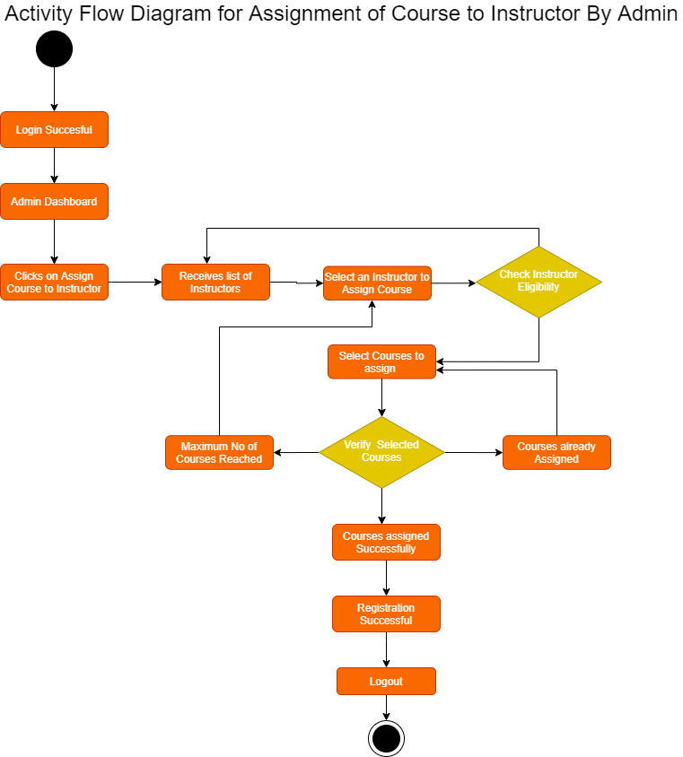
Activity Diagram for Assignment of Course
CODELEARNERSHUB

Slide 16
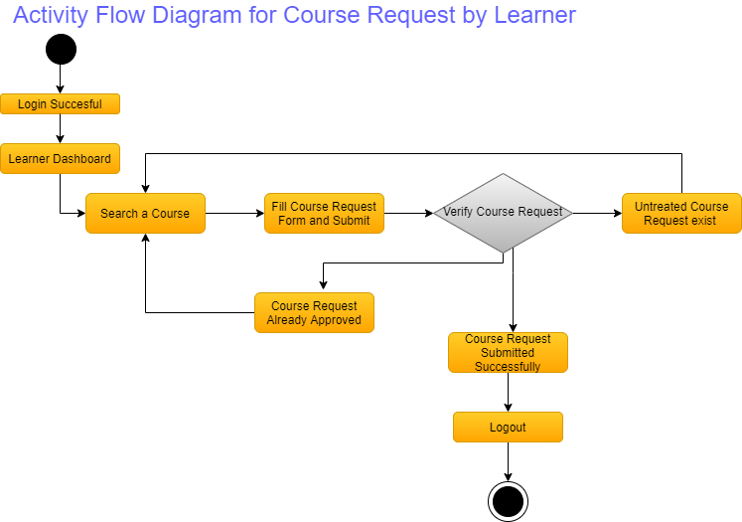
Activity Diagram for Course Request
CODELEARNERSHUB

Slide 17
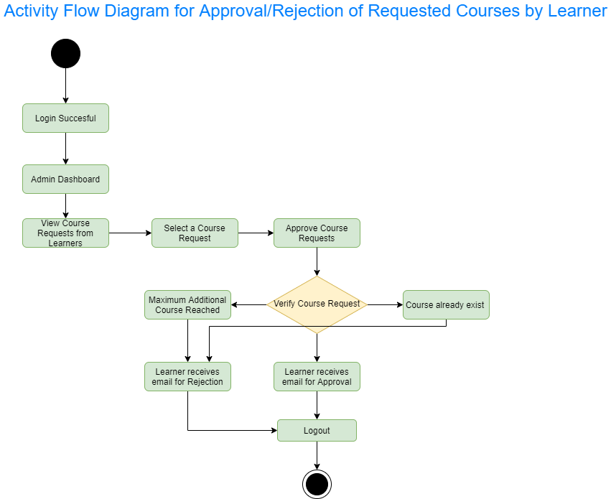
Activity Diagram for Approval/Rejection of Course Request
CODELEARNERSHUB

Slide 18
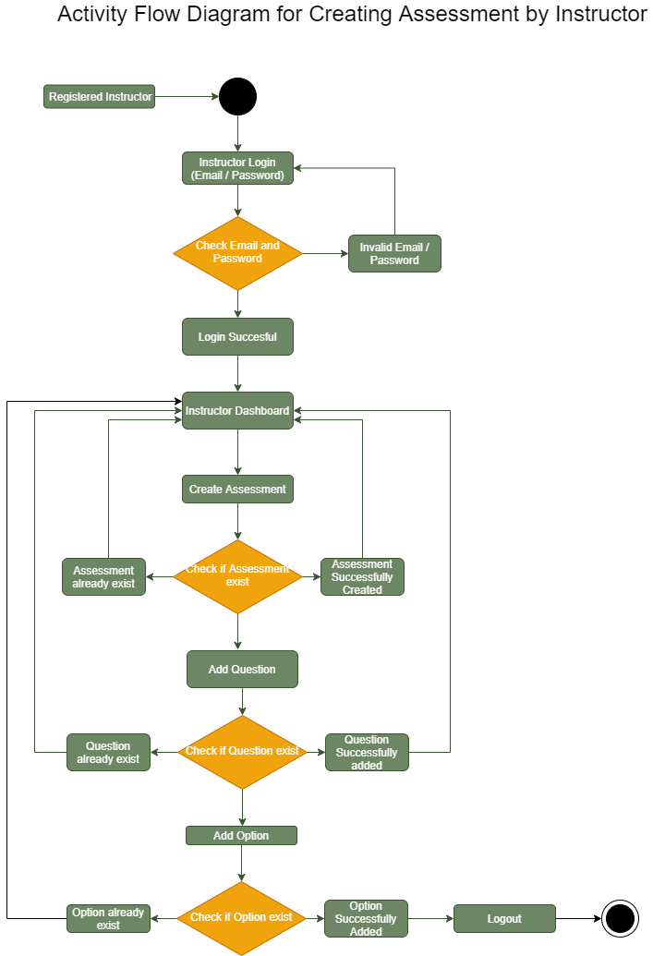
Activity Diagram for Creating Assessment
CODELEARNERSHUB

Slide 19
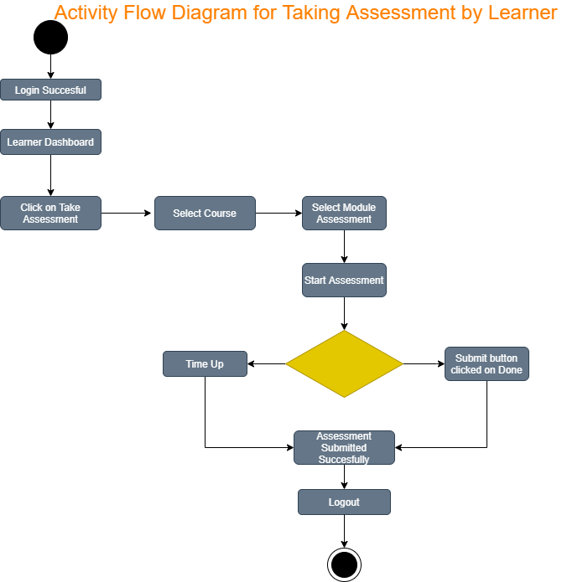
Activity Diagram for Taking Assessment
CODELEARNERSHUB

Slide 20
Expected Contribution To Learning System
CODELEARNERSHUB
Consistency of Learning
Easy tracking and reporting
Keeps your Course Up-to-date
Better results through engagement and gamification
ULMS additionally offers tracking of learner’s progress through alerting Instructor / Admin of learner’s poor performances, assignment of supplementary courses to Learner through special groups and recommended time to complete a course

Slide 21
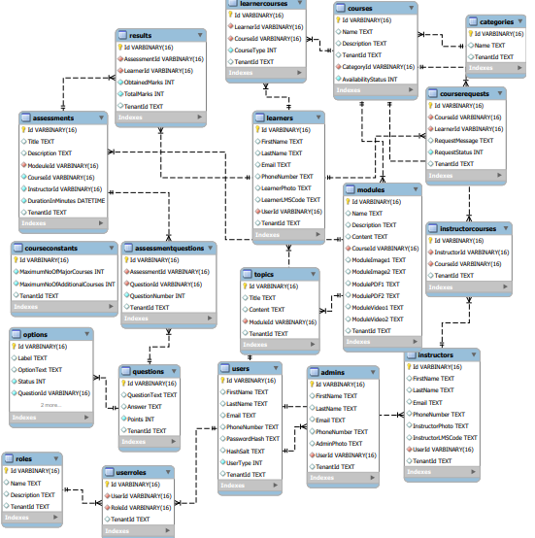
Entity Relationship Diagram
CODELEARNERSHUB

Slide 22
CODELEARNERSHUB
THANKS FOR LISTENING

Slide 23
The Important Of Console Application
It is Flexible
It is readable i.e. (Easy to understand code ).
Reusability.
.maintainability
Reliable.

